Slide 1
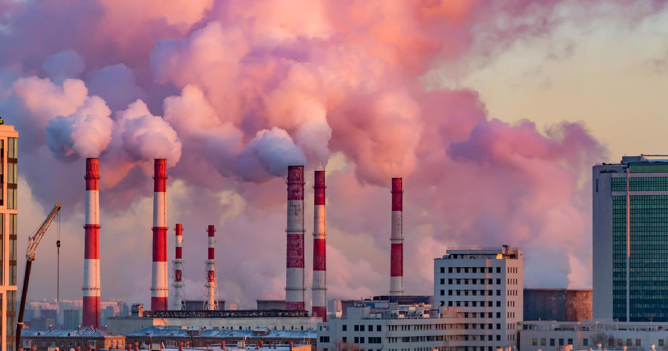

Air Quality Monitoring

Slide 2
Project Definition
The project involves integrating IoTsensors into air quality measurement to monitor pollution free, health care, realtime monitoring, energy efficiency. The goal is to help protect human health and the environment from the harmful effects of air pollution. Theproject includesprojectobjectives, IoTdevicesetup, platformdevelopment, code implementation and real-time air quality monitoring system which raise public awarenessaboutairquality andhealthimpact.

Slide 3
Project Objective
Sensor Development
DeployinganetworkofIoTsensorstomeasure key air quality parameters, such as particulate matter (PM), nitrogendioxide (NO2),ozone(O3),andothers.
Real-Time Monitoring
Establishing a real-time monitoring system to collect continuousand instantaneous data on air quality.
Data Analytics
Employingdataanalyticsandmachinelearning algorithms to analyze the collected data, identify patterns, andpredictairqualitytrends.
Alert Systems
Developingautomatedalertsystemsthatnotify relevant stakeholders or the public when air qualitylevelsexceedpredefined thresholds.

Slide 4

Integration with Existing System
Integrating IoTair quality data with existing environmental monitoring systems anddatabases for acomprehensive view.
Energy Efficiency
Designing IoTdevices and systemswith a focus on energy
efficiencytoensuresustainableandlong-term operation.
Scalability
Creating a scalable infrastructure that can accommodate anincreasingnumberofsensorsand datapointsastheproject expandsUser.
Feedback Mechanism
Establishingafeedbackmechanismtogatherinsights from users and continuously improve the system basedontheir experiencesandneeds.

Slide 5
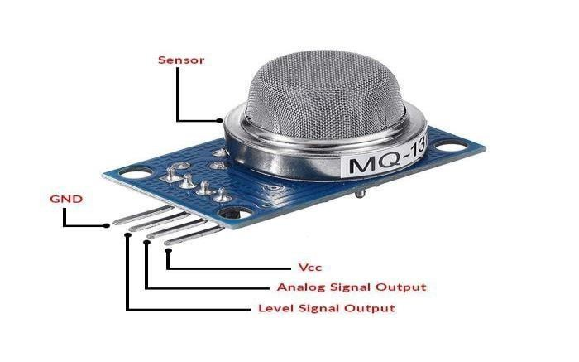
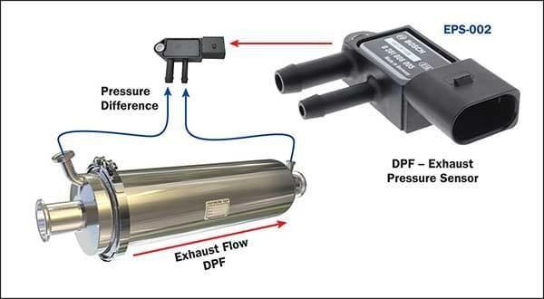
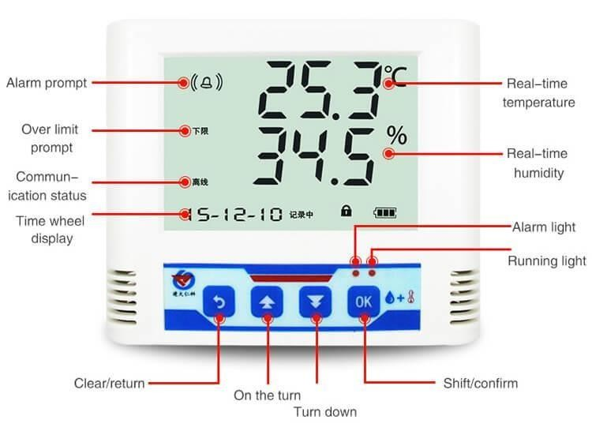
IOT device setup for Air quality
GasSensors
Gas Sensors
These sensors are widely used for detecting gases such
Temperature and
Humidity Sensors
Thesesensorsmeasureboth temperatureandhumidity, providingessentialdatafora comprehensive understandingof environmentalconditions.
as carbon monoxide methane (MQ-4), and They provide analog proportional to concentrationofthegas.
(MQ-7),
others. output
the
ParticulateMatterSensors
Particulate Matter
Sensors
Thesesensorscanmeasure theconcentrationof particulatematterintheair, helpingtoassessairquality.
TemperatureandHumidity sensors

Slide 6
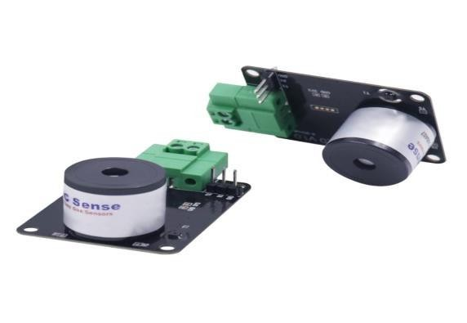
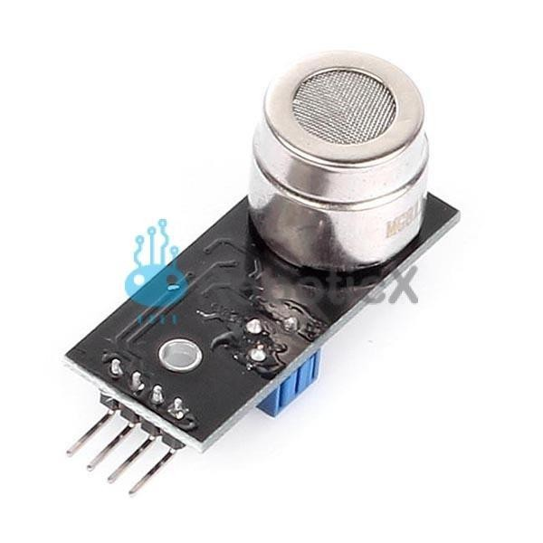
Carbon Di Oxide (CO2)Sensors
Carbondi oxide
Sensors
CO2sensorsarecrucialforassessingindoorair quality. Theymeasure the concentration of carbondioxidein theair.
Ozone (O3) Sensors
Thissensorcandetectvariousgases,including ozone, and is commonly used in air quality monitoring systems.
Ozonesensors

Slide 7
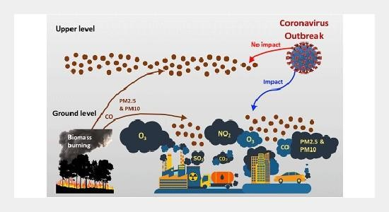

Platform Development
Developing a platform for air quality in IoTinvolves integratingsensorstocollectairqualitydata,utilizing a communicationprotocol likeMQTT,andcreatingauser interface fordatavisualization. Considerscalability, real- time analytics,andsecurityinyourdesign.

Slide 8
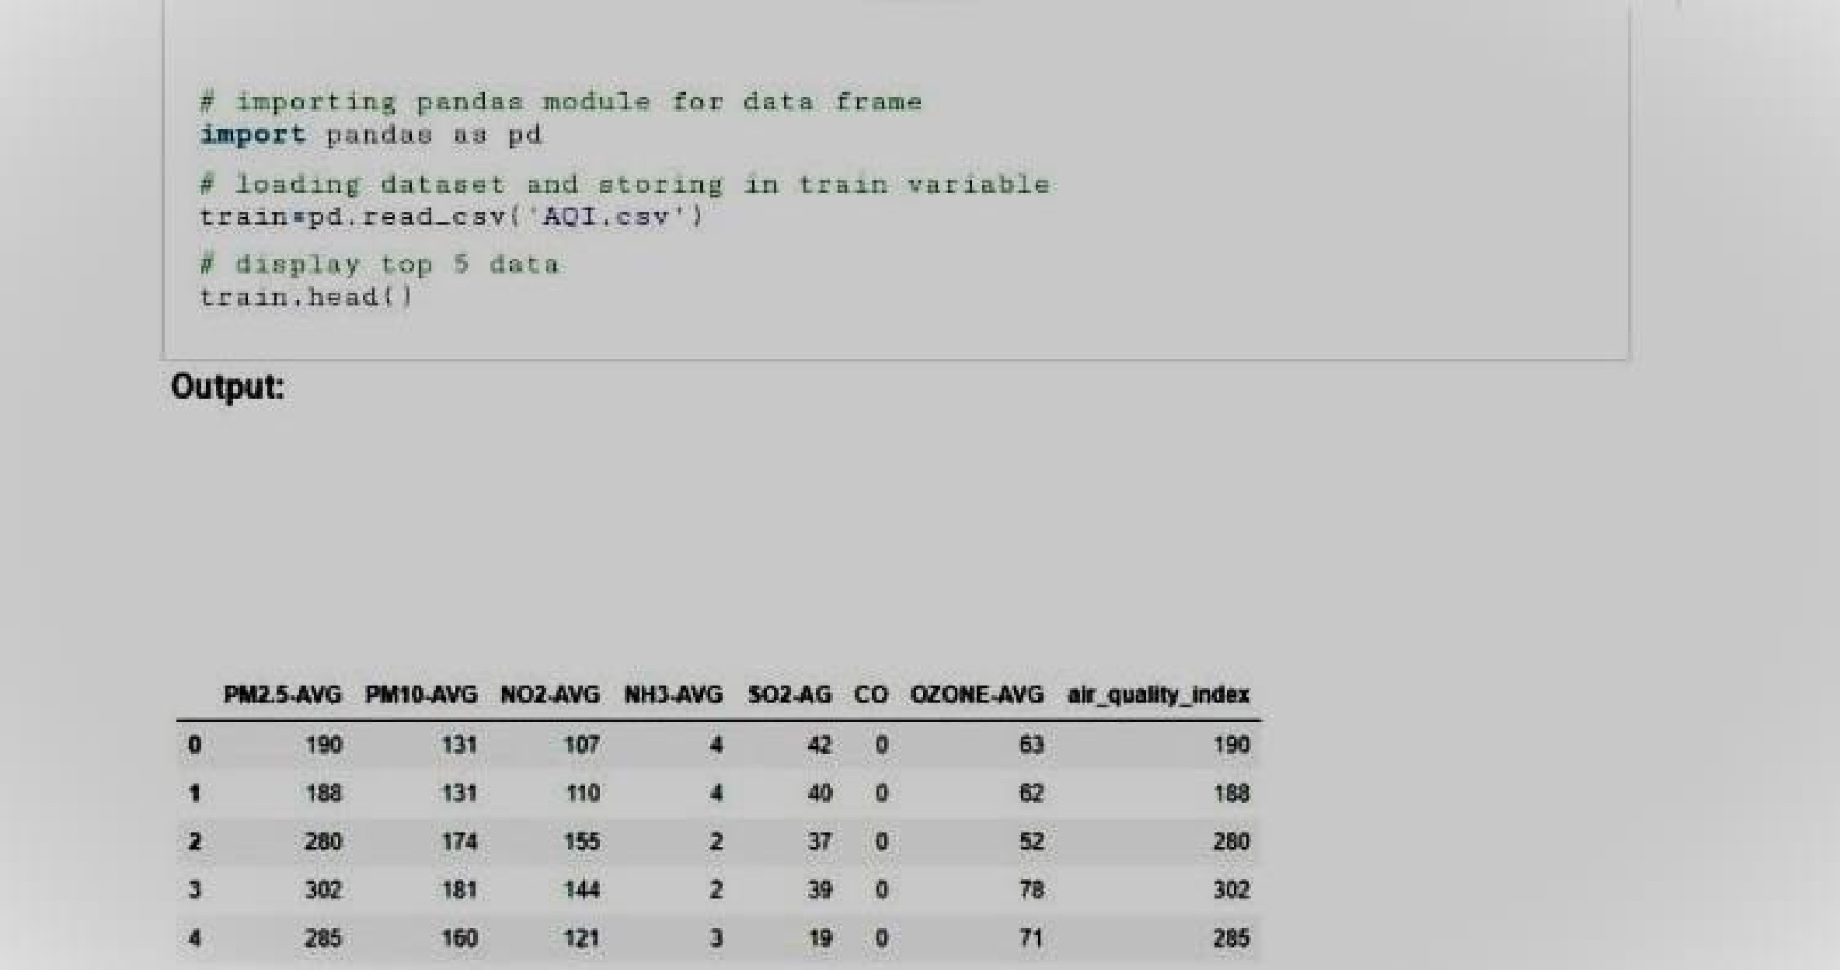


Code Implementation
Company overview

Slide 9
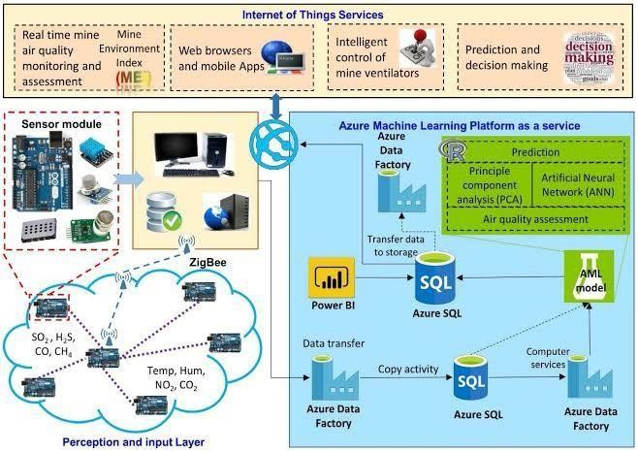
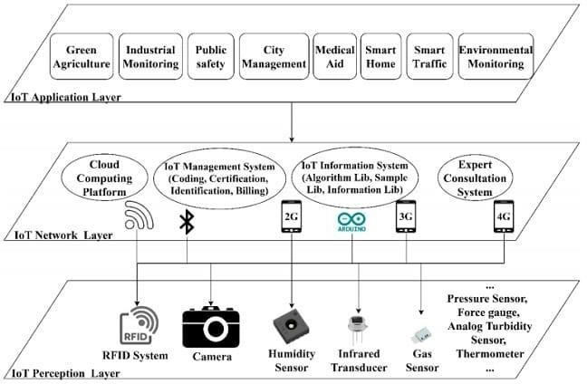
Screenshots of IOT Devices and Data Sharing Platforms

Slide 10
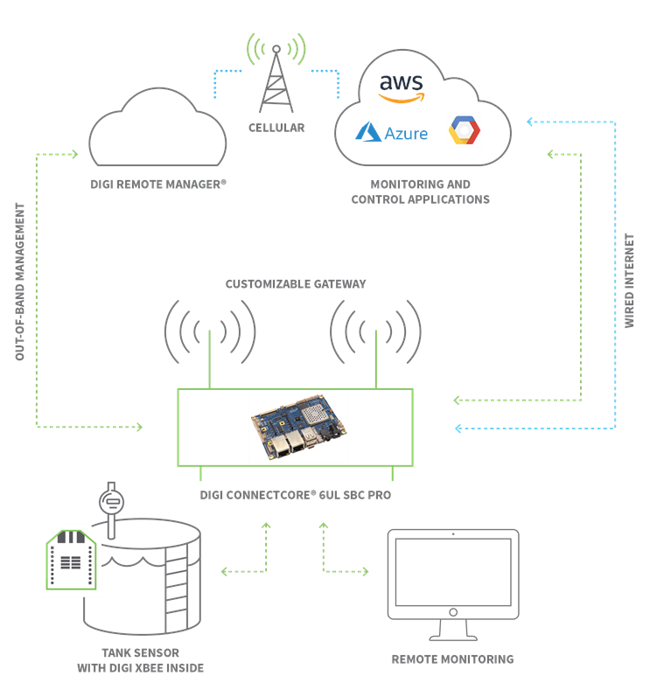

Diagram Of IOT Devices And Data Platform

Slide 11
Public Awareness and Education
In Town Hall meetings held by the AQMD, residents throughout the South Coast basin have asked how the public can become more involved in reducing local air pollution impacts in their communities. Local governments are encouraged to invest in public outreach activities and programs to build strong public awareness of regional and local air quality issues and health studies.air quality issues and health studies. To foster greater community involvement and support in developing public policy, local jurisdictions should consider the following activities to improve awareness of air quality and environmental justice issues. identify an individual as a contact person for environmental justice issues. participate with the AQMDin Town Hall meetingstohearcitizenconcerns regardingairqualityandenvironmentaljustice.

Slide 12
Suggested Goal, Objectives and Policies/ Strategies
Suggested policies/Strategies related to Public Awareness
AQ6.1.1Provide regional and local air quality informationonCity’swebsite,includinglinkstothe AQMD,CARB,USEPAandotherenvironmentalbased internetsites.
AQ6.1.2Organize city-sponsored events on topics that educate businesses and the public about compliance with airqualityregulations(e.g.,alternativefuelsandlow polluting cleanhouseholdproducts).
Goal 6Greater publicawareness ofthechangesin personalbehaviourthatcanbechosentominimize air pollution
Objective6.1Makeairqualityeducationapriorityforthe City’sefforttoprotect
publichealthandachievestateandfederalcleanair
standards

Slide 13
EXPLANATION
Air quality monitoring involves the systematic observation and measurement of various pollutants and factors in the air, such as particulate matter, gases (like ozone, carbon monoxide, sulphur dioxide), volatile organic compounds, and more. Monitoring stations equipped with sensors or devices collect data on these pollutants to assess air quality levels. This data is used to understand pollution trends, inform the public about potential health risks, and support the implementation of policies or actions aimed at improving air quality. The measurements obtained are often compared to established air quality standards to determine if the air quality is safe or if it poses risks to human health and the environment.

Slide 14

Avoid
Air Pollution
Thank you
GITHUB LINK:https://github.com/kaviya-324/IOT-AirQuality-Monitoring.git
Kaviya k
422621104019
University college of engineering, Panruti

